Slide 1
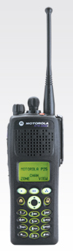
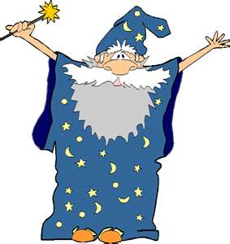
Radio In Plain Language
Any sufficiently advanced technology is indistinguishable from magic. (Arthur C. Clark)
Pay no attention to the man behind the curtain. (Wizard of Oz)
This 20 minute tutorial aims to take the mystery out of radio so you can be an informed customer.

Slide 2
Radios Are Everywhere . . .
A cell phone is a radio
A wireless mouse is a radio
A garage door opener is a radio
A keyless lock for a car door is a radio
Cable and Satellite TV are both radios
A speed pass for a toll bridge is a radio
A security tag in a department store is a radio
It would be hard to avoid radio in modern life

Slide 3
It all started when . . .
1835 – Samuel Morse proved that signals could be transmitted by wire.
  He used pulses of current to deflect an electromagnet, which moved a marker to produce written codes on a strip of paper.
1873 – James Clerk Maxwell described the theoretical basis of the propagation of electromagnetic waves.
Morse Code

Slide 4
Over 130 years ago . . .
The microphone
The Amplifier
Frequency Measurements are named after this guy . .
As in “Megahertz”
1876 – Thomas Edison invented the carbon telephone transmitter.
1883 – Edison patented the first vacuum tube, that controlled the flow of electric current.
1888 – Heinrich Hertz demonstrated the theory of electromagnetic waves.
1894 – Guglielmo Marconi built a receiver that rang a bell when lightening was detected.
When his father saw the device he took all of the family money and invested in his son’s work . . . (Smart move) The company is still making radios today.

Slide 5
Bose is an historic family name in India. There is no relationship between this guy and the Bose Audio Corp.
Theory led to experiments . . .
1894 – Indian physicist, Jagadish Chandra Bose, demonstrated the use of radio waves in Calcutta, but he was not interested in patenting his work.
1897 – Marconi demonstrated “Telegraph without wires,” transmitting a signal 6 Km.
1897 – Nikola Tesla’s experiments with radio frequency energy led to the first US Patents for radio. He used sensitive electromagnetic receivers, the design used today.

Slide 6
Then practical applications . . .
MYTH BUSTER
SOS does not mean “Save Our Ship.”
The three letters were adopted as they are easy to send and recognize in Morse Code.
The acronym only works in English . . SOS is an international standard for all languages.
3 Letter Codes
Morse Code operators used 3 letter codes to abbreviate standard messages because they were quicker to send and receive.
Today, people do the same thing with Text Messaging codes. It’s nothing new . . .
1901 – Marconi transmitted a message across the Atlantic, from England to Newfoundland.
Thereafter the “Marconi Wireless Telegraph” was put into practical use on ships . . . And the rest (as they say) is history.
1906 – SOS was adopted as the official international standard for distress calls, though Marconi operators continued to use CQD for some time thereafter.
Tesla commented: "Marconi is a good fellow. Let him continue. He is using 17 of my patents.”

Slide 7
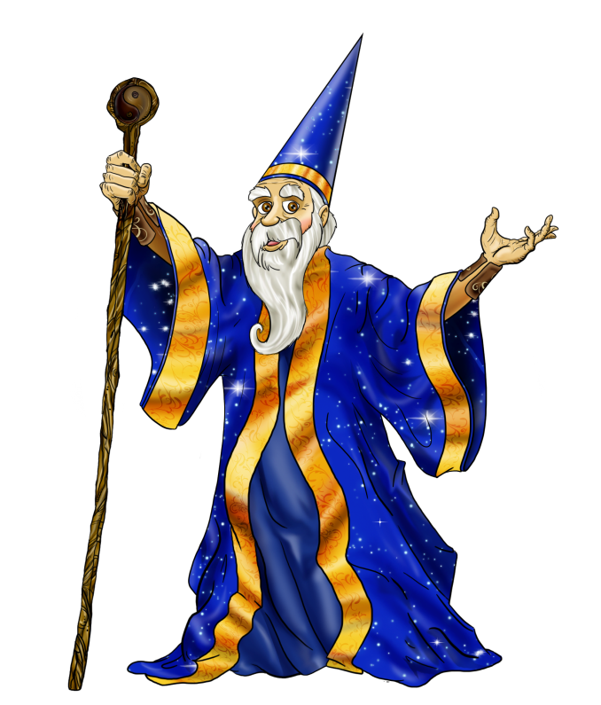
Radio Theory . . .
Some very smart and clever people built on a series of ideas to develop radio as we know it today . . .
Now, let’s explore the mysteries of the radio wizards.

Slide 8
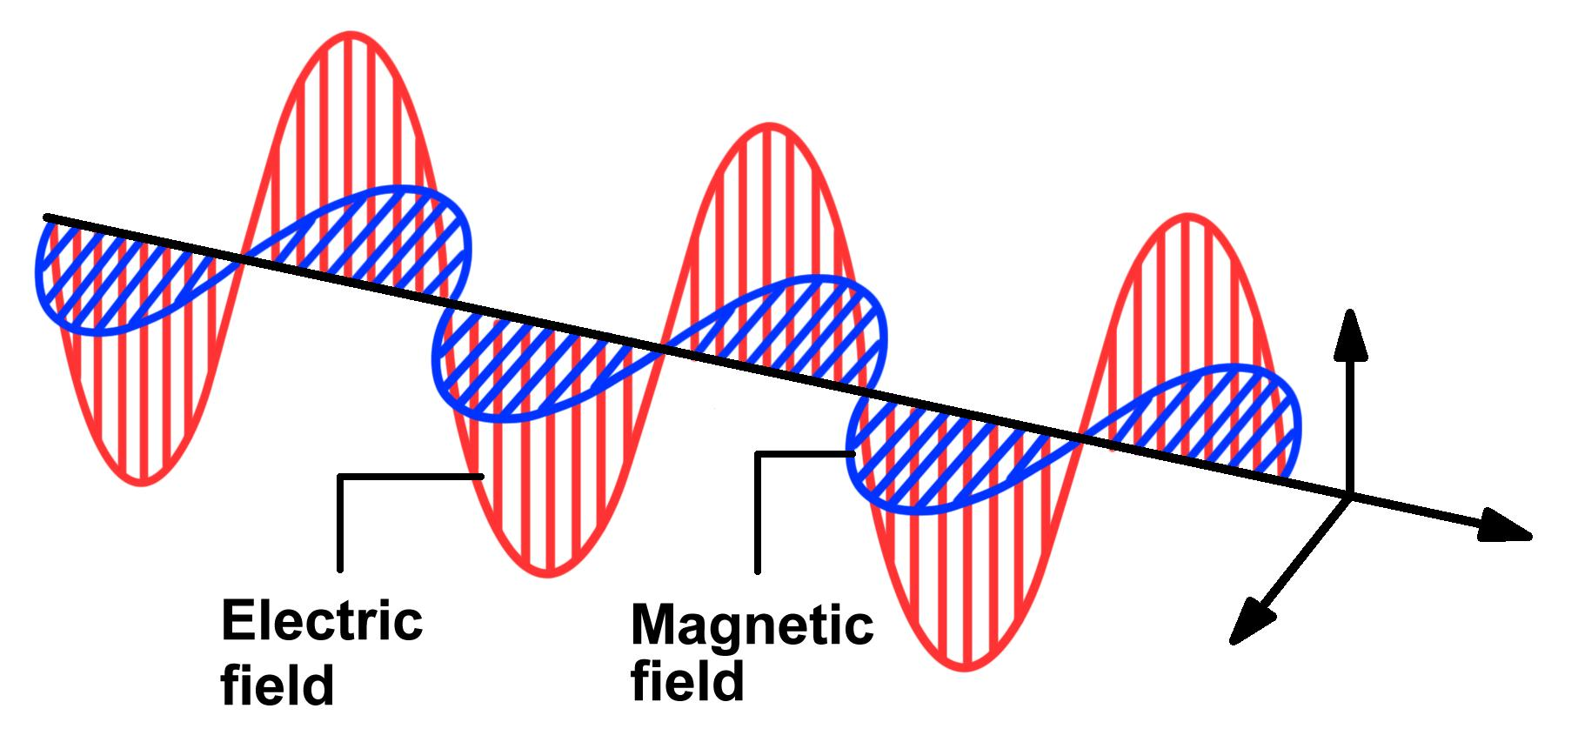
Here’s how it works . . .
Electrical and magnetic fields are formed when electricity moves through a wire.

Slide 9
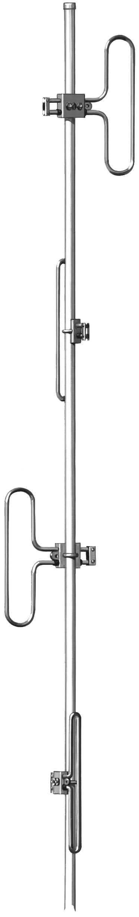
That energy will radiate from one antenna to another.
Tesla had the idea that usable amounts of electricity could be moved without wires.
It was a great idea, but it didn’t worked because of the losses between antennas.
Those losses are HUGE: running in the range of a trillion-to-one and more.
Transmitter Receiver

Slide 10
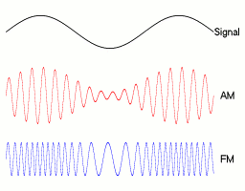
The radiating energy carries the message; that’s why it called a “Carrier.”
Modulation combines the audio signal with the carrier changing either amplitude (AM) or frequency (FM).
Digital modulation uses a combination of AM and FM modulation to convey more information in each ‘symbol.’
For example: 64 bit digital modulation
8 amplitudes X 8 frequencies
64 possible combinations = 1 symbol

Slide 11
All radios have the same basic elements
Sensitive Audio Amplifier
Modulator
Antenna
Microphone
Early radios had a large manual switch that the operator would flip over to change from transmit mode to receive mode.
Radio operators would end each transmission with the word “OVER” to announcing that they changing from transmit to receive.
The word has stuck in radio usage.
RF Oscillator
Switch
RF Power Amplifier
TRANSMITTER
Audio Power Amplifier
Sensitive RF Amplifier
Demodulator
Tuner
Speaker
RECEIVER

Slide 12
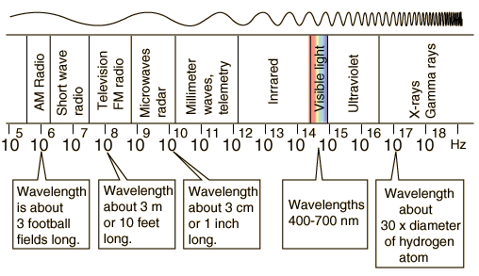
Spectrum . . . where it happens
High Frequency
Short Wave Length
Low Frequency
Long Wave Length
“Spectrum” refers to all of the frequencies

Slide 13
Spectrum . . . the Rules
Spectrum is a limited resource.
    There are only so many frequencies.
Different frequencies propagate differently.
    Higher frequencies are more “line-of-sight.”
Terrain limits propagation more distance
    Radio doesn’t go through or around rocks.
Separation allows frequency re-use
    If there is enough either terrain or distance.
Careful coordination limits interference
    It’s part of the FCC licensing process.

Slide 14
Radio Spectrum . . . the Bands
AM Radio
520 – 1620 KHz
BAND | FREQUENCY | Wave Length
Very Low Freq. (VLF) | 10 KHz > 30 KHz | 30 Km > 10 Km
Low Freq. (LF) | 30 KHz > 300 KHz | 10 Km > 1 Km
Medium Freq. (MF) | 300 KHz > 3 MHz | 1 Km > 100 Meters
High Freq. (HF) | 3 MHz > 30 MHz | 100 Meters > 10 Meters
Very High Freq. (VHF ) | 30 MHz > 300 MHz | 10 Meters > 1 Meter
Ultra High Freq. (UHF) | 300 MHz > 3 GHz | 1 Meter > 100 Cm
Super High Freq. (SHF) | 3 GHz > 30 GHz | 100 Cm > 10 Cm
Extremely High Freq. (EHF) | 30 GHz > 300 GHz | 10 Cm > 1 Cm
FM Radio
87.8 – 108 MHz
VHF 2-Way Radio
144 – 172 MHz
Television
54–82, 174–210, 470–800 MHz
UHF 2-Way Radio
420 – 512 MHz
Microwave
900 MHz – 32 GHz

Slide 15
Radio Systems . . .
Now that we have the basic building blocks, let’s weave some magic and see what makes up various radio systems.

Slide 16
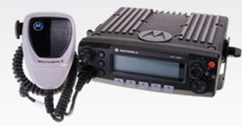
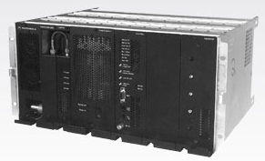
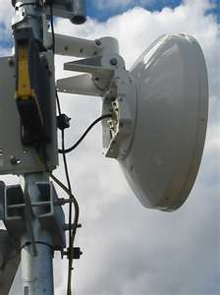
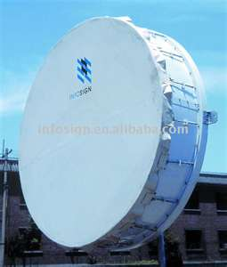
Four Types of Radios . . .
Portable Radio
Mobile Radio
Base Radio / Repeater
Point-to Point Microwave
Design is always about “trade-offs” – to enhance one aspect another is compromised.
This really shows in the different types of radios

Slide 17
Portable Radio
  1 – 5 Watts RF Power
  Power from Battery
  Compact Antenna
(+) Compact Size
(+) Easy to Carry
(-) Limited Power
(-) Limited Antenna
Power and performance are traded to get small size.
The limited power becomes an issue in infrastructure design.

Slide 18
Mobile Radio
  25 – 100 Watts RF Power
  Power from Vehicle
  Good Antenna on Metal Roof
(+) Strong Signal
(+) Quality Antenna
(+) Many Options
(-) Vehicle Mount
The mobile radio is the workhorse of two-way radio.
A wide range of features are offered to fit differing requirements and budgets.

Slide 19
Base Radio / Repeater
  25 – 1000 Watts RF Power
  Power from AC or Solar
  High Performance Antenna
A base radio is designed for high-reliability with high technical specifications.
It is meant to function in the RF intense world of a radio site.
(+) High Quality
(+) Strong Signal
(-) High Cost
(-) Fixed Location

Slide 20
Microwave
In 1946, Dr. Percy Spencer was testing a new vacuum tube that generated micro-waves. He realized that the candy bar in his pocket had melted. This was intriguing; so he placed some popcorn near the tube and watched as the kernels exploded all over his lab.
The next day he tried with an egg, inviting a colleague to watch. The rapid heating led to an equal rise in pressure in the egg. Just as the curious colleague moved closer to look, the egg exploded.

Slide 21
The microwave oven is NOT the microwave used in radio communications.
  Tissue heating from exposure to RF energy is a safety issue for radio techs, but not radio users.
  The danger rises when the combined power level rises above 1,000 watts @ < 30 feet.
  That can happen at radio sites but not with a mobile or portable radio.
  There is more E/M radiation exposure from a hair dryer than a two-way radio.
A Word About Safety

Slide 22
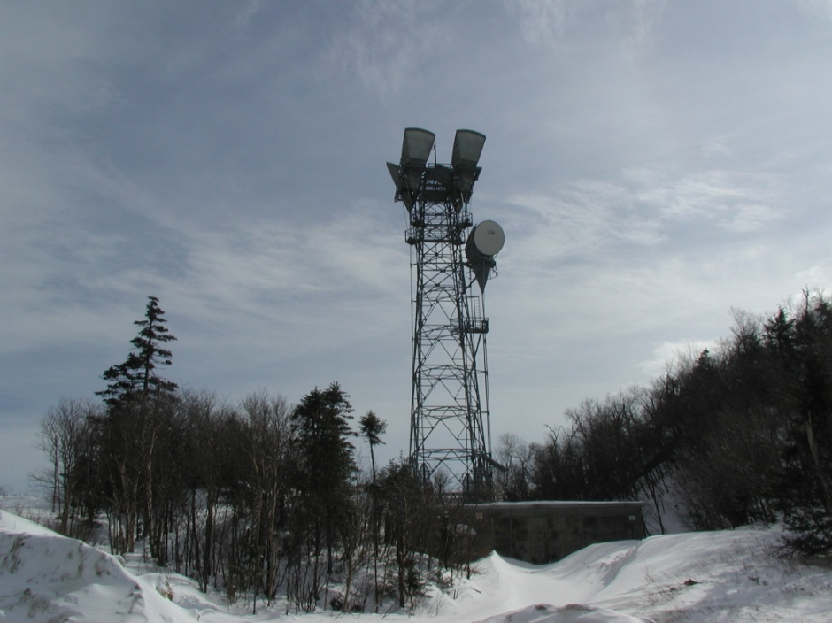
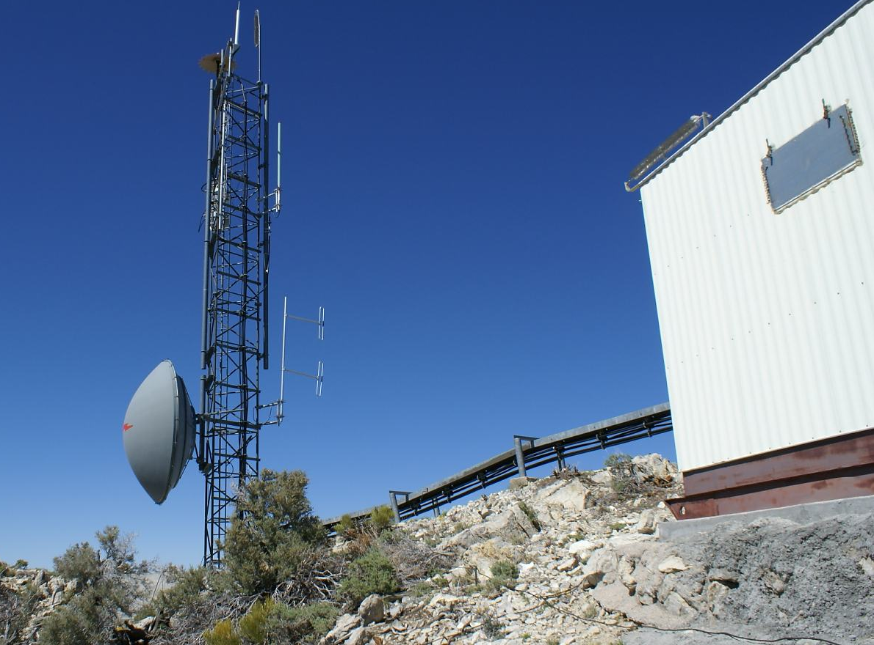
Point-to-Point Microwave is like a high-capacity phone or data line that crosses from hilltop to hilltop.
That connection allow the creation of radio networks that span wide areas.
Dish antennas focus the microwave energy (usually 1 watt) into tight beams to compensate for the high signal losses.

Slide 23
Basic Modes of Operation . . .
Simplex
Duplex / Repeater
Remote Control
Control Station

Slide 24
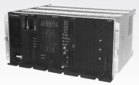
Simplex
All radios transmit and receive on the same frequency.
151 MHz
151MHz
151MHz
151 MHz
151 MHz

Slide 25
Range can be improved by putting the base radio on higher ground with Remote Control
151 MHz
Remote Controls are telephone-like devices that pass audio to the transmitter and from the receiver.
151MHz
Remote Control

Slide 26
Duplex / Repeater
Radios transmit and receive on different frequencies.
151 MHz
Repeater
159 MHz
159 MHz
151 MHz
A Repeater allows users separated by terrain to communicate with each other.

Slide 27
Receive audio is fed to the transmitter to make a “Repeater.”
It transmits what it receives . . .
That’s why it’s called a “Repeater”
Audio Amplifier
151 MHz
Modulator
Antenna
Microphone
RF Oscillator
A special filter, called a “Duplexer” replaces the switch.
This allow the transmitter and receiver to operate at the same time
RF Power Amplifier
Filter
159 MHz
Audio Power Amplifier
Sensitive RF Amplifier
Demodulator
Tuner
Speaker

Slide 28
Radio Repeater. . .
Repeaters can be used in several ways.
To improve unit-to-unit communications
    (Shown in the previous illustration.)
To extend local dispatch range by combing a repeater with another radio.
To improve portable performance for a user operating from a vehicle
To extend range over a thousand miles

Slide 29
Combining a remote, a base, and a repeater extends coverage further.
Control Station
151 MHz
Repeater
159 MHz
159 MHz
151 MHz
A fixed radio used to access a repeater is called a “Control Station”
Remote Control

Slide 30
A “Vehicular Repeater” (VR) is a special application of a repeater that travels with the vehicle.
The vehicle is equipped with a mobile radio and VR radio with controller.
The VR extends the user’s portable radio by linking the portable to the users mobile radio.
It works well to have the VR on a different frequency band than the mobile radio.
159 MHz
151 MHz
Repeater
450 MHz
Vehicular
Repeater
450 MHz
The user gets the flexibility of a portable radio, linked to the more powerful range of the mobile radio.

Slide 31
Something Special. . .
The higher the repeater above the surrounding terrain the farther the range.
What would happen if a repeater were installed 22,223 mile above the surrounding terrain?

Slide 32
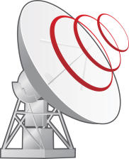
A “Satellite Repeater” provides great range.
Because satellites are so expensive, they are packed with multiple repeaters that serve a wide range of customers.
Repeater
2245 MHz
2345 MHz
Earth
Station
Some customers are stationary (Satellite TV and long distance telephone); others may be mobile.
At 22,223 miles and 7,000 mph a satellite will match the rotational speed of the earth and be stationary relative to the ground.
Satellite
Radio
The coverage area of a geostationary satellite can be an entire continent and the surrounding oceans.

Slide 33
Radio Networks . . .
Combining the building blocks provides the features and coverage area required.
Complexity, User Experience, and Cost are traded in the design of a radio system.
Difficult USER EXPERIENCE Easy
Cost
Cost
Technical Complexity

Slide 34
Typical Radio Network
Each site has its coverage area and ideally overlaps the next site
Microwave
Microwave
Microwave
Repeater
#3
Repeater
#2
Repeater
#4
Repeater
#1
A “Dispatch Console” is a complex remote control that accesses all sites via phone lines and/or microwave links
Dispatch Console

Slide 35
Manual Site Select Network
Console and connections deleted for clarity
Repeater
#3
Repeater
#2
Repeater
#4
Repeater
#1
BUT . . . if they select the wrong site communications will be poor.
Training and experience are needed to know which channel works in a given area.
Each user must select the correct channel on their radio to access the repeater for their location

Slide 36
Auto Receiver Site Select Network
This is also known as “Receiver Voting”
Repeater
#3
Repeater
#2
Repeater
#4
Repeater
#1
95%
5%
75%
Receiver
Selector
0%
The Receiver Selector chooses the receiver based on signal quality
Dispatch Console
#2 Selected

Slide 37
Auto Transmit Select Network
This is also known as “Vote and Steer”
Repeater
#3
Repeater
#2
Repeater
#4
Repeater
#1
95%
5%
75%
Receiver
Selector
0%
Receiver selection occurs using the same Receiver Selector as before.
The Controller activates a repeater transmitter based on the Receiver Selector choice
The Controller maintains the connection so the Dispatcher may reply
Dispatch Console
Transmit
Controller
#2 Selected

Slide 38
Vote and Steer Benefits
Reduces the complexity for the user, and thus reduces training requirements.
Relieves users of the need to change channels as they move about.
Eliminates errors in selecting the correct channel / site for a give location.

Slide 39
Simultaneous Transmit Network
This is also known as “Simulcast”
Repeater
#3
Repeater
#2
Repeater
#4
Repeater
#1
95%
5%
75%
Receiver selection occurs using the same Receiver Selector as before.
The Controller activates all transmitters simultaneously.
Receiver
Selector
0%
Dispatch Console
Transmit
Controller
#2 Selected

Slide 40
Simultaneous Benefits
Connects multiple sites to work as one single repeater.
Field units and dispatchers can send or receive from any location without regard for user location.
Provides greater unit-to-unit communications than vote-and-steer.

Slide 41
Trunked Radio Networks
Trunking automates the communications process, like a cell phone.
Provides the best user experience; users can focus on their work instead of radio.
Trunked systems are flexible, reliable, and resource efficient.
Radio sites and repeaters become shared resources available to all users.

Slide 42
Trunked Radio “Talk-Groups”
User Channels are called “Talk-Groups” as they define who the user talks with rather than the frequency or site.
As many Talk-Groups as needed may be created – It’s software not hardware.
User specific Talk-Groups provide for regular work without overlap.
Shared Talk-Groups provide for interoperability to work together.

Slide 43
Trunked Radio “Talk Groups”
Emergency Ops
Talk-Group
Public Works
Talk-Group
Common Ops
Talk-Group
Law Enforcement Talk-Group
Road Construction Talk-Group
Emergency Medical Talk-Group
Fire
Talk-Group
Engineers
Talk-Group

Slide 44
A Trunked Radio Site has:
A Control Channel
  Several voice channels
A Trunking Controller to manage the site
Trunking Controller
Control
Channel
Voice #1
Voice #2
Voice #3
Trunked Radio Site

Slide 45
Trunking Process
Voice channels are assigned when requested.
Trunking Controller
Control
Voice #1
Voice #2
Voice #3
Assignment
Messages can now be sent between units in the talk group using the assigned voice channel.
When one unit hit the Press-to-Talk a request is sent on the control channel.
The Trunking Controller assigns a voice channel to the talk-group
Request
All units in the talk-group respond to the assignment and switch to the voice channel.
Voice Messages
Talk Group #122
Talk Group #214
Talk Group #433

Slide 46
Trunking Process
Voice channels are assigned to other groups as needed.
Trunking Controller
Control
Voice #1
Voice #2
Voice #3
Voice Messages
Voice Messages
Voice Messages
Talk Group #122
Talk Group #214
Talk Group #433

Slide 47
Trunking Process – Multi-Site
Channels are assigned at multiple sites if users in a same talk-group are not served by the same site.
Network Controller
Assignment
Request
Site 1
Voice Messages
Voice Messages
Assignment
Site 2
Talk Group #122
Talk Group #122

Slide 48
Trunked Efficiency
The number of channels at a site is a function of the call volume rather than the number of talk-groups.
Users may roam from area to area without changing channels.
Users may be partitioned to their own talk-group or cooperate on shared talk-groups for improved interoperability.

Slide 49
Trunked Reliability
If a channel stops working, the controller sends an alarm to the technicians and won’t assign the channel to users.
Thus, users never lose communications because their talk-group is not lost by the loss of a voice channel at a site.
If a site loses connection with the network it will still work. User radios prefer a site with network access.

Slide 50
Radio Over IP (RoIP) . . .
The advent of Internet Protocol and Ethernet networks changed the way radio systems are interconnected.
RoIP is more efficient and reliable than

Slide 51
Pop Quiz . . .
True or False: A repeater transmits and receives on the same frequency.
True or False: Exposure to small amounts of RF energy can cook human tissue.
Microwave is used (A) to connect radio sites, (B) to heat your lunch.
True or False: Trunking is more complex than other radio networks.
False: A repeater uses different transmit and receive frequencies.
False: It takes a lot and you have to be close.
Both are true; they are two different types of microwave device.
Trick question: It’s more complex for the technician but less complex for the user.

Slide 52
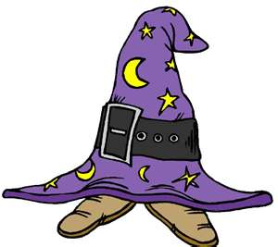
Radio In Plain Language
Any sufficiently advanced technology is indistinguishable from magic. (Arthur C. Clark)
Even if you understand how something works, that it actually works is still magical.
You’ve looked behind the curtain and should now be able to distinguish technology from magic.
But, did all of the physics and chemistry
just happen by random chance, or
is there a master magician?

Slide 53
Radio In Plain Language
2012
Tom Mahon
Radio Communications Project Manager
Washington Department of
Natural Resources
tom.mahon@dnr.wa.gov

